Slide 1
MALIGNANT COMMENTS CLASSIFICATION PROJECT
Presented By-
Satyam Tripathi

Slide 2
INTRODUCTION Business Problem Framing
The proliferation of social media enables people to express their opinions widely online. However, at the same time, this has resulted in the emergence of conflict and hate, making online environments uninviting for users. Although researchers have found that hate is a problem across multiple platforms, there is a lack of models for online hate detection.
Online hate, described as abusive language, aggression, cyberbullying, hatefulness and many others has been identified as a major threat on online social media platforms. Social media platforms are the most prominent grounds for such toxic behaviour.
There has been a remarkable increase in the cases of cyberbullying and trolls on various social media platforms. Many celebrities and influences are facing backlashes from people and have to come across hateful and offensive comments. This can take a toll on anyone and affect them mentally leading to depression, mental illness, self-hatred and suicidal thoughts.
Internet comments are bastions of hatred and vitriol. While online anonymity has provided a new outlet for aggression and hate speech, machine learning can be used to fight it. The problem we sought to solve was the tagging of internet comments that are aggressive towards other users. This means that insults to third parties such as celebrities will be tagged as unoffensive, but “u are an idiot” is clearly offensive.
Our goal is to build a prototype of online hate and abuse comment classifier which can used to classify hate and offensive comments so that it can be controlled and restricted from spreading hatred and cyberbullying.

Slide 3
Conceptual Background of the Domain Problem
Online platforms and social media become the place where people share the thoughts freely without any partiality and overcoming all the race people share their thoughts and ideas among the crowd.
Social media is a computer-based technology that facilitates the sharing of ideas, thoughts, and information through the building of virtual networks and communities. By design, social media is Internet-based and gives users quick electronic communication of content. Content includes personal information, documents, videos, and photos. Users engage with social media via a computer, tablet, or smartphone via web-based software or applications.
While social media is ubiquitous in America and Europe, Asian countries like India lead the list of social media usage. More than 3.8 billion people use social media.
In this huge online platform or an online community there are some people or some motivated mob wilfully bully others to make them not to share their thought in rightful way. They bully others in a foul language which among the civilized society is seen as ignominy. And when innocent individuals are being bullied by these mob these individuals are going silent without speaking anything. So, ideally the motive of this disgraceful mob is achieved.
To solve this problem, we are now building a model that identifies all the foul language and foul words, using which the online platforms like social media principally stops these mob using the foul language in an online community or even block them or block them from using this foul language.

Slide 4
Review of Literature
Identify the foul words or foul statements that are being used.
Stop the people from using these foul languages in online public forum.
To solve this problem, we are now building a model using our machine language technique that identifies all the foul language and foul words, using which the online platforms like social media principally stops these mob using the foul language in an online community or even block them or block them from using this foul language.
I have used 5 different Classification algorithms and shortlisted the best on basis on the metrics of performance and I have chosen one algorithm and build a model in that algorithm.
Motivation for the Problem Undertaken
One of the first lessons we learn as children is that the louder you scream and the bigger of a tantrum you throw, you more you get your way. Part of growing up and maturing into an adult and functioning member of society is learning how to use language and reasoning skills to communicate our beliefs and respectfully disagree with others, using evidence and persuasiveness to try and bring them over to our way of thinking. Social media is reverting us back to those animalistic tantrums, schoolyard taunts and unfettered bullying that define youth, creating a dystopia where even renowned academics and dispassionate journalists transform from Dr. Jekyll into raving Mr. Hydes, raising the critical question of whether social media should simply enact a blanket ban on profanity and name calling? Actually, ban should be implemented on these profanities and taking that as a motivation I have started this project to identify the malignant comments in social media or in online public forms.

Slide 5

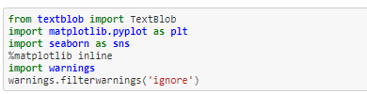
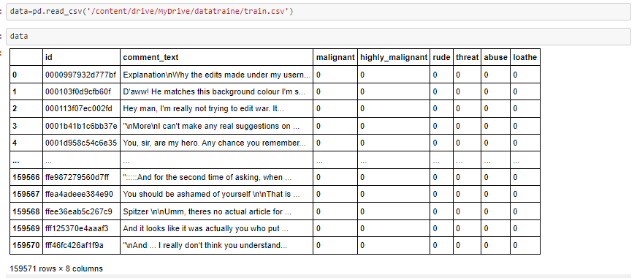
Analytical Problem Framing
Mathematical/ Analytical Modelling of the Problem
Importing Libraries for preprocessing and feature engineering
Loading dataset and checking no. of rows and columns
As we can see there are comments that contains many things like emoji and unwanted texts like stopwords and all so we cant feed this things to our model because if I am going to feed all this it will increase the model complexity and overall these words are not important for my mode.
Ex-if I will give you a example like “You are really a awesome person”
Now my model will focus on ‘awesome’ word here so basically awesome and person word are important for this sentence.

Slide 6
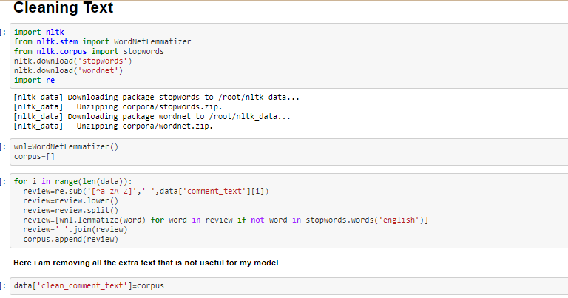
Cleaning Text
This code will help me to clean my all text that are present in this dataset.

Slide 7
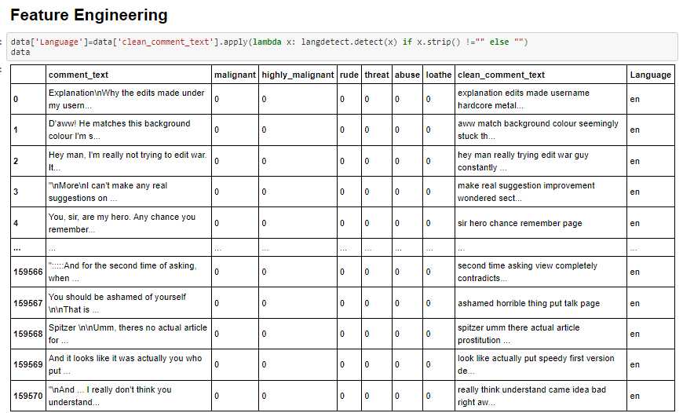
Feature Engineering
Here I am doing feature engineering so I can understand my data more
Like here I am adding a column that is language which will show me which comment is belong to which language and it will also help me to understand what is the percentage of comments text that belong to which language.

Slide 8
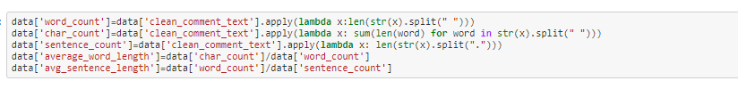
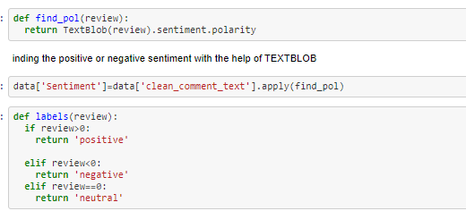
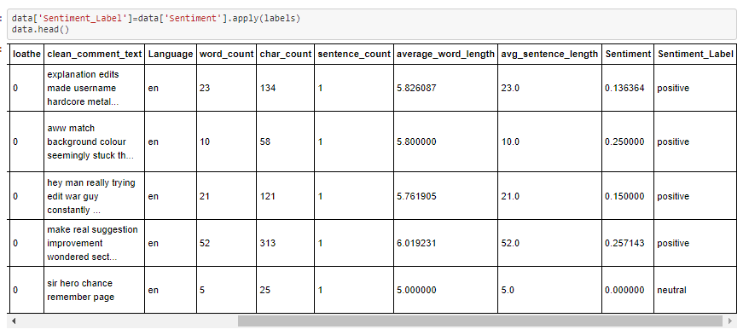
Feature Engineering
Here also I am adding more columns that you can see in this snapshot.
Here I am adding sentiment polarity as we know in this dataset we have many sentiments like malignant, highly malignant, rude,
abuse and all. So basically I am checking here how many are positive and negative and neutral.

Slide 9
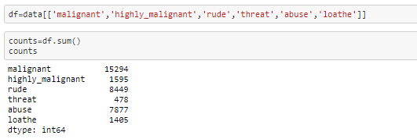
EDA
Checking Count of Each Comments-
As we can see there are comments labels which are imbalanced if I am going to feed this to my model my model will not able to
understand about other classes which have less count so I need to balance all the things but first I am doing EDA.

Slide 10
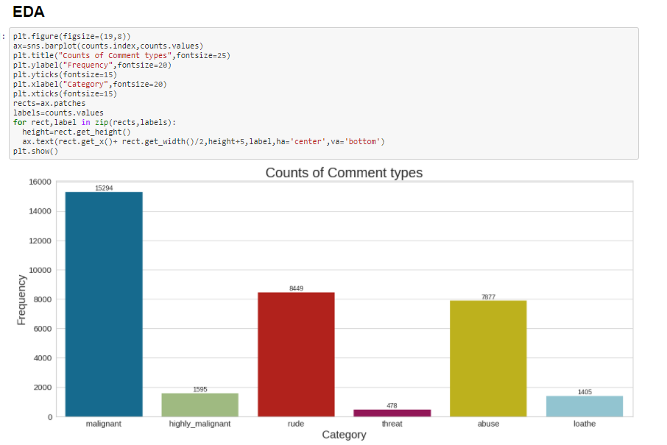
EDA-
As we can see this Countplot shows us that malignant has the high count and threat and loathe has less count means mostly of
the people who comment that belong to malignant class.

Slide 11
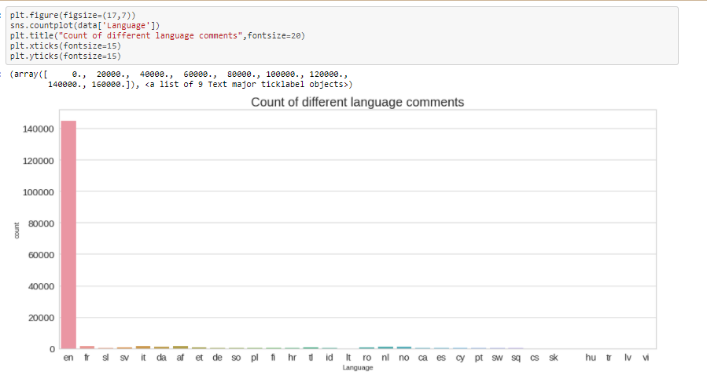
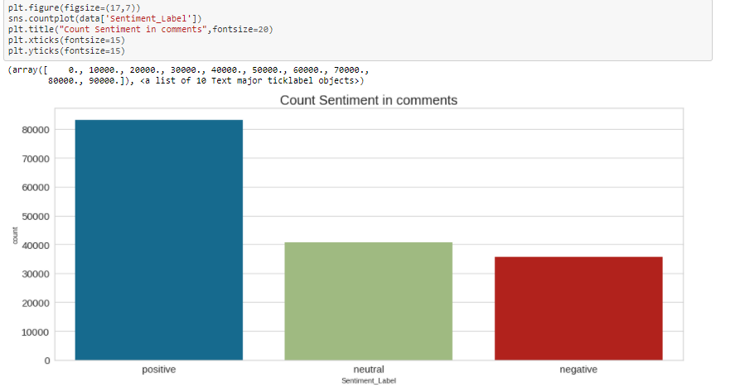
CountPlot Of Language-
Countplot of Sentiments-
As we can see there are many comments that belong to only English and very few comment that belongs to other languages.
As we can see there are mostly comments that are positive and then
mostly comments are neural after then we have negative comments
and in negative we can many labels like malignant, highly malignant,
rude, abuse and all.

Slide 12
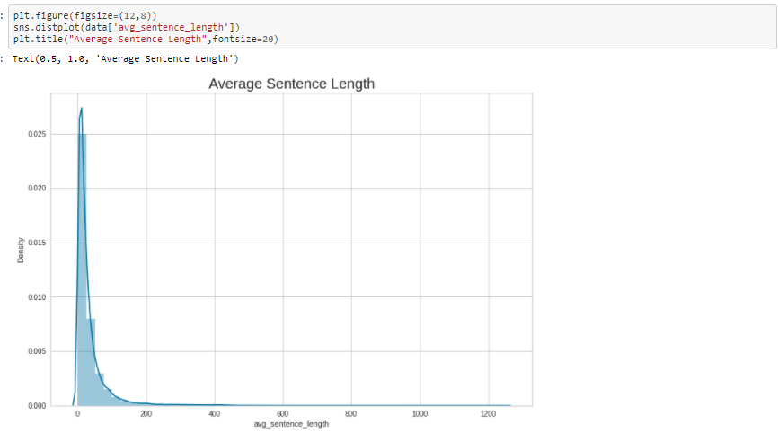
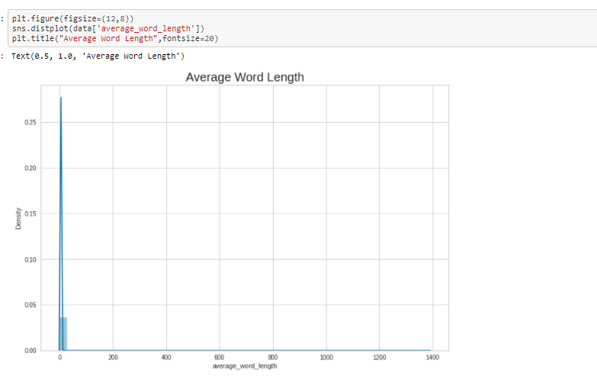
Average Sentence Length-
The average length of comment lies between 0-50 and there are also many peoples who use to do long comments like 1200 long also.
The average word length of most of the comments is between 0-20
with the above graph i can see which comment type is having more count.

Slide 13
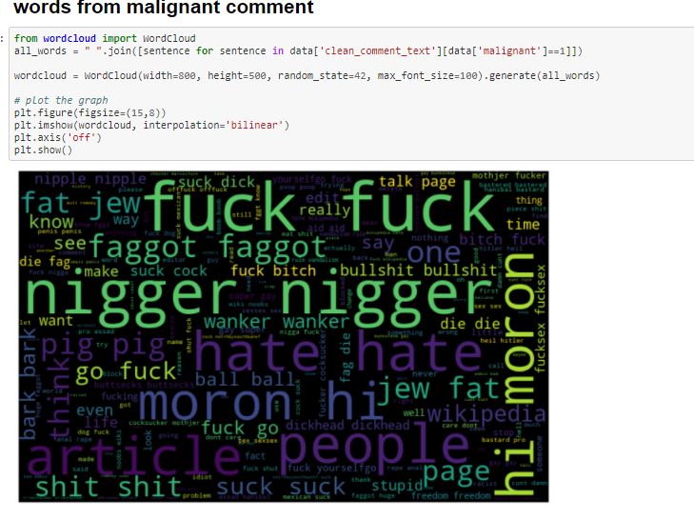
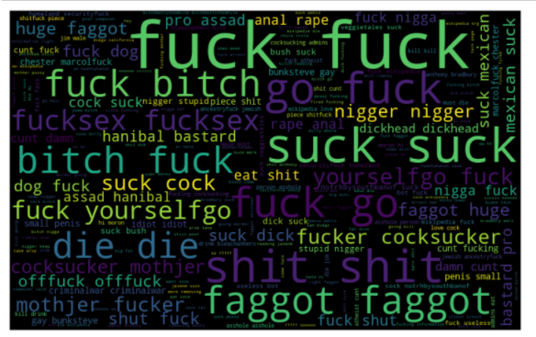
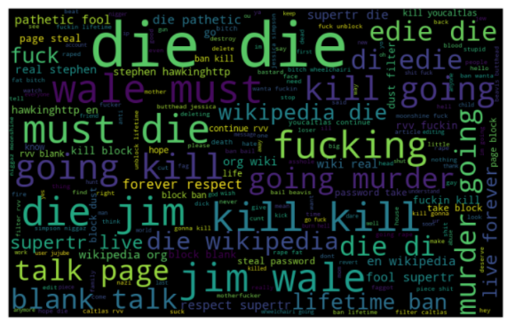
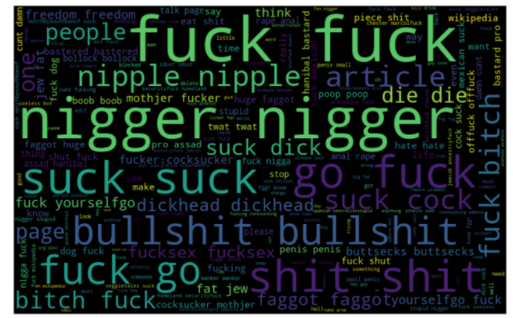
Data Inputs- Logic- Output Relationships
I have analysed the input output logic with word cloud and I have word clouded the sentenced that as classified as foul language in every category.
Words From Highly Malignant Comments
Word from Threat Comments
Words from Rude comments

Slide 14
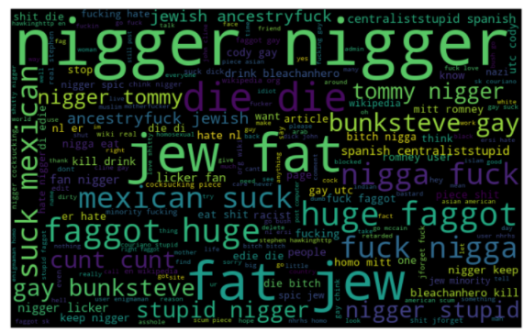
Word from Threat Comments
Word from loathe comments
Words from Rude comments
These are the comments that belongs to different type so which the help of wordcloud we can see if there is abuse comment which type of words it contains and similar to other comments as well.
These are the comments that belongs to different type so which the help of wordcloud we can see if there is abuse comment which type of words it contains and similar to other comments as well.

Slide 15
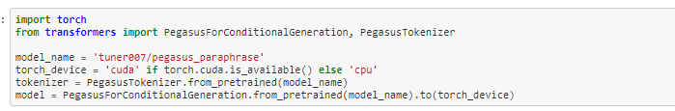
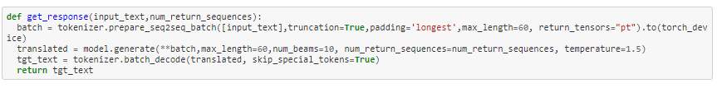
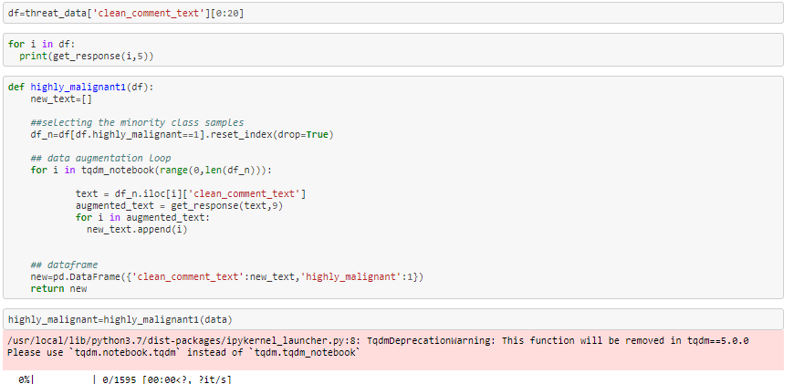
Data Augmentation
As we have seen above we have a total imbalanced dataset so I have to balance it so my model can understand each
and every comment label so for the I will be using NLP Data Augmentation Techniques like Transformer Models.
Which the Help of this code and transformers library and model I will be able to create many other comments that are similar to the original comments.

Slide 16
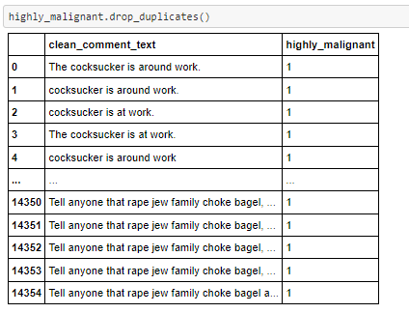
As we can see in this upper snapshot of the comments this is how transformer model is able to create similar kind of text so after this I can add more flexibility to the model.
Same thing I have did with other labels as well like some labels was having only 500 count like threat so I have generated 15 texts from one sentence so I will be equal to the higher count of label like malignant comment.
So finally at the end after augmentation I was able to create similar kind of text now all my labels have approx. 15000 counts.

Slide 17
Hardware and Software Requirements and Tools Used
Python 3.8.
NumPy.
Pandas.
Matplotlib.
Seaborn. 6. Data science.
SciPy
Sklearn.
NLTK
Transformers
Google colab

Slide 18
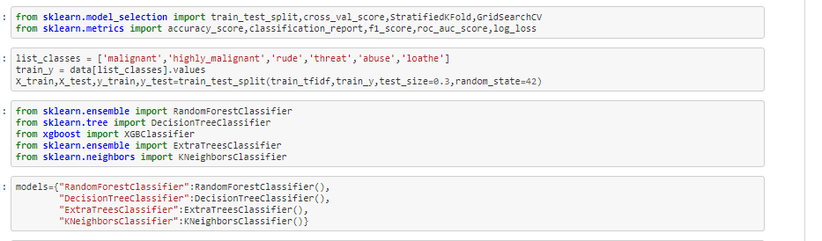
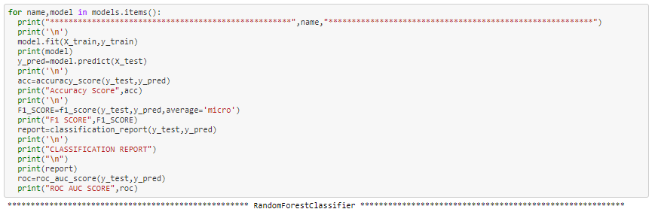
Model/s Development and Evaluation
Training Models-

Slide 19
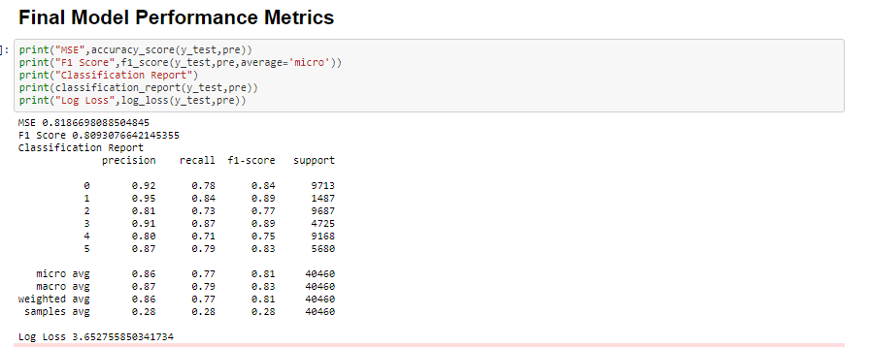
Here I have used some tree base model for better accuracy.
And from all of the above model ExtraTreesClassifier was giving me good accuracy so I have picked it as a final model.
Final Model Performance Metrics

Slide 20
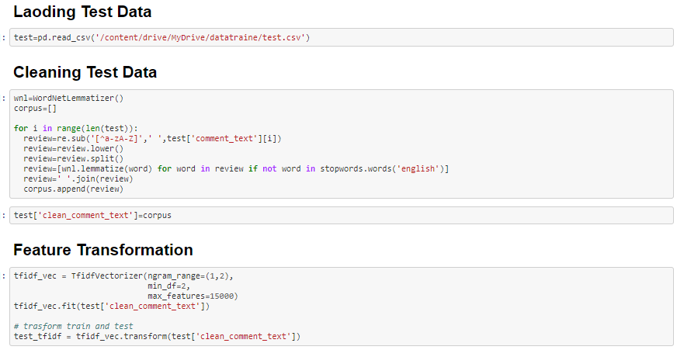
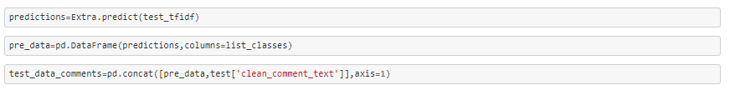
Test Data-
Loading the test data and cleaning it for prediction.

Slide 21
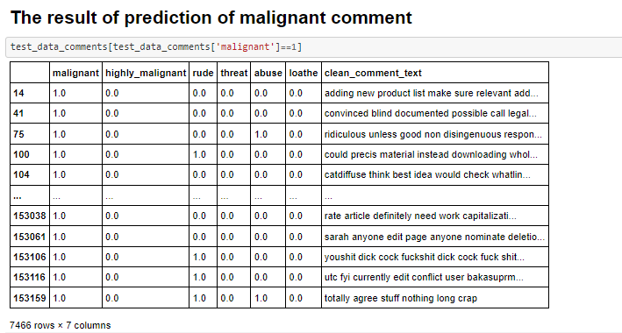
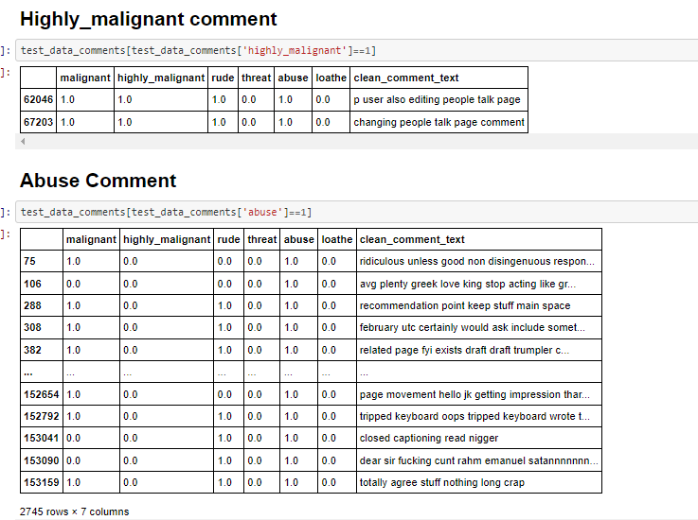
Predicted Results For Malignant comments and others-

Slide 22
CONCLUSION
Key Findings and Conclusions of the Study
The finding of the study is that only few users over online use unparliamentary language. And most of these sentences have more stop words, and are being long. As discussed before few motivated disrespectful crowds uses these foul languages in the online forum to bully the people around and to stop them from doing the things that they are suppose to do. Our Study helps the online forms and social media to induce a ban to profanity or usage of profanity over these forms.
Learning Outcomes of the Study in respect of Data Science
The use of social media is the most common trend among the activities of today’s people. Social networking sites offer today’s teenagers a platform for communication and entertainment. They use social media to collect more information from their friends and followers. The vastness of social media sites ensures that not all of them provide a decent environment for children. In such cases, the impact of the negative influences of social media on teenage users increases with an increase in the use of offensive language in social conversations. This increase could lead to frustration, depression and a large change in their behaviour. Hence, I propose a novel approach to classify bad language usage in text conversations.

Slide 23
I have considered the English medium for textual conversation. I have developed our system based on a foul language classification approach; it is based on an improved version of a Random Forest Classification Algorithm that detects offensive language usage in a conversation. As per our evaluation, we found that lesser number of users conversation is not decent all the time. We trained 190000 observations for eight context categories using a Random Forest algorithm for context detection. Then, the system classifies the use of foul language in one of the trained contexts in the text conversation. In our testbed, we observed 10% of participants used foul language during their text conversation. Hence, our proposed approach can identify the impact of foul language in text conversations using a classification technique and emotion detection to identify the foul language usage.
Limitations of this work and Scope for Future Work
The limitation of the study is that we have a imbalanced data so our model learnt more about the non-abusive sentence more than the abusive sentence. Which makes our model act like a overfit model when tested with live data. And also, model tend to not identify a foul or a sarcastically foul language.

Slide 24


